Slide 1

TOPIC:SMART SANITKA
TEAM MEMBERS:
Sujith Selvaraj
Janani.R.S
TEAM: Tech_Minions
MENTOR:
Mr.Ganesh Prabhu,Asst.Prof ECE

Slide 2

SMART SANITKA
SRI KRISHNA COLLEGE OF TECHNOLOGY
COIMBATORE

Slide 3

WHY &WHAT?
IPR STATUS:
Applied as “Smart Sanitka”
APPLICATION NO :
202141033870

Slide 4
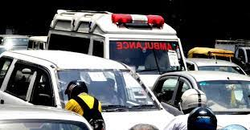
PROBLEM STATEMENT
The Ambulances often get stuck at the traffic signals where all other vehicles try to squeeze.

Slide 5

SOLUTION??

Slide 6
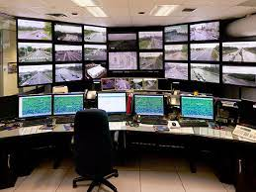
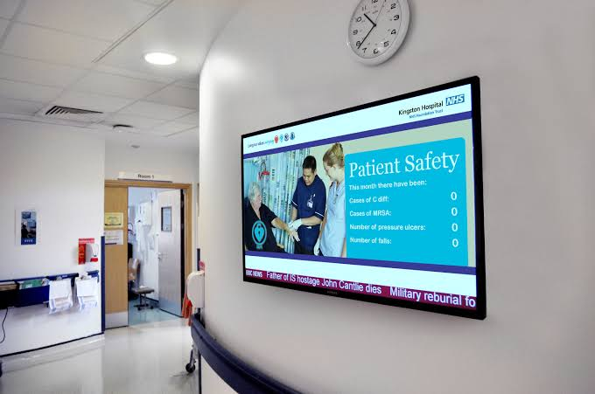
PROPOSED SOLUTION
Informing the Traffic control room inorder to change the signal.
Alerting to hospital.

Slide 7

HOW TO EXECUTE?

Slide 8
COMPONENTS REQUIRED
Neo-6m-GPS with Aurdino.
LoRa sx1278 module.
LoRa receiver.
LCD display.
GSM sim 900 .
Battery.
SOFTWARE:
Arduino IDE
ARDUINO CODE:
https://github.com/sujithselvaraj/Smart-Santika/tree/main

Slide 9
WORKING
Ambulance
Neo-6m-GPS
Sharing live location
GSM SIM 900
LCD
Alerting hospital about Emergency
Control room
LoRa SX1278
Sharing the Allocated Hospital name
Hospital
LoRa receiver
LCD display

Slide 10
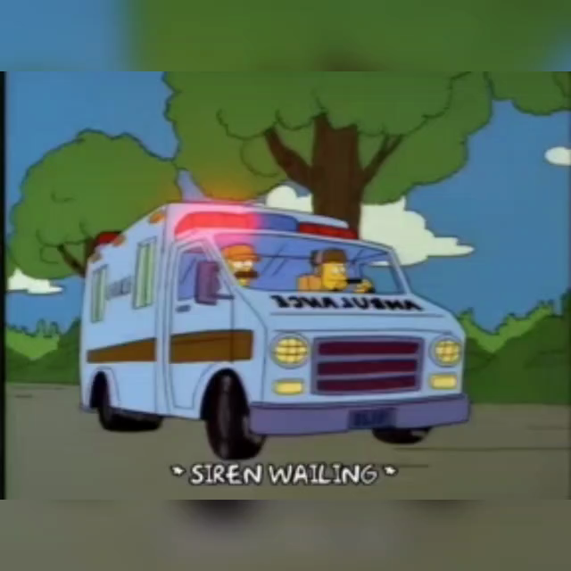

Slide 11
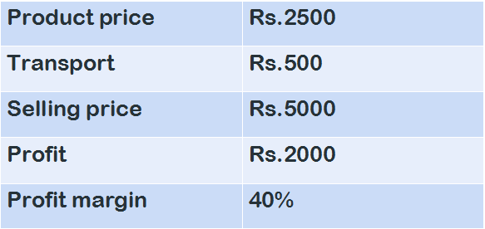
REVENUE STREAM

Slide 12
To check the availability of bed,oxygen cylinders & medicine through this Government server link.
https://tncovidbeds.tnega.org/
REFERENCE:
IOT based Ambulance tracking and Road clearance.
Intelligent Road / Traffic monitoring for Ambulance alert system.

Slide 13
QUESTIONS???
1
Why LoRa?
2
How it is Driver friendly?
3
Why don’t we inform through phone call?
4
Why not informing hospital from Ambulance?
ANY OTHER QUESTIONS ?

Slide 14

THANK YOU !

